Slide 1

KIET Group of Institutions, Ghaziabad COMPUTER SCIENCE DEPARTMENT project id: PCS23-52 DOMAIN: FULLSTACK+ML
SUBMITTED BY: Vikas Jindal
Vishal Aggarwal
Vishal verma

Slide 2


PROJECT TITLE:
Socially
.

Slide 3
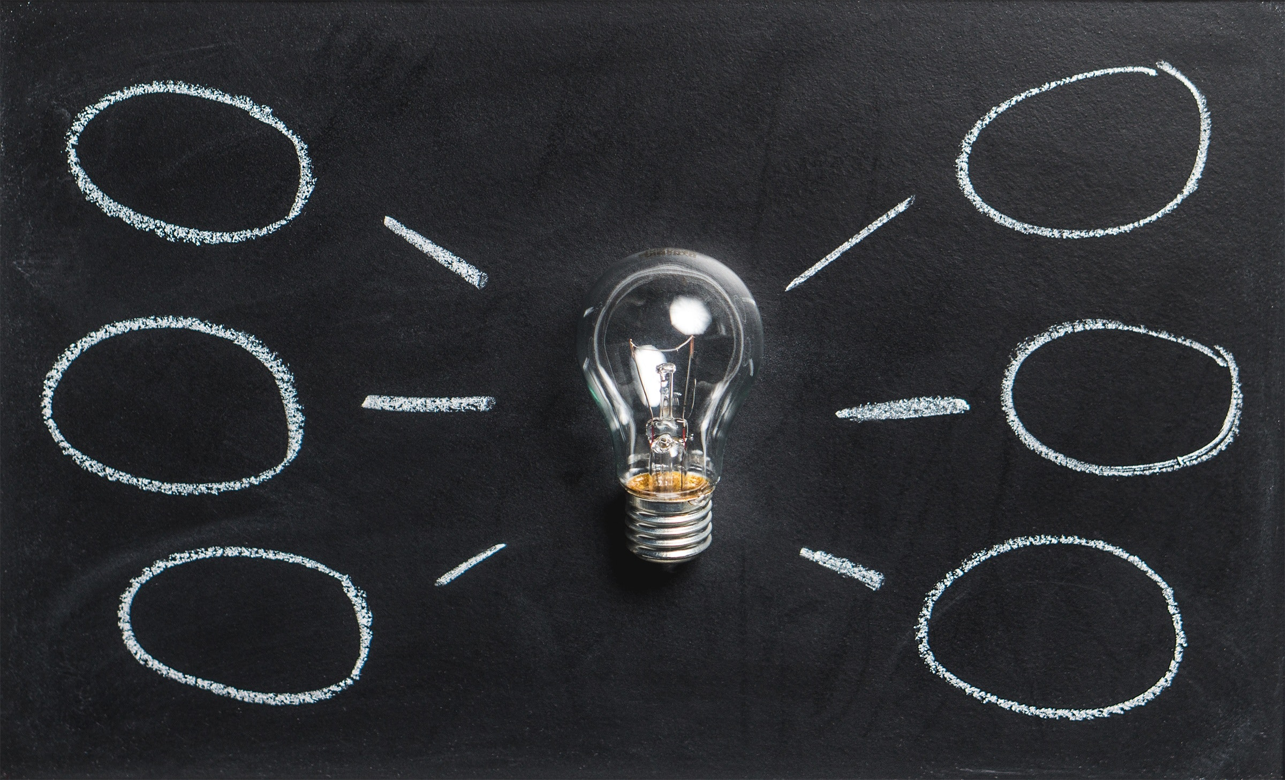
PROBLEM STATEMENT:
Let's suppose you're living in a remote area with scarce population. What is one medium which can let you make connections with the rest of the world or can make you feel connected with everyone? In order to market your product or services what is one thing that can turn out to be the easiest and the cheapest solution? Name the medium which is used both the educational as well as recreational purpose?

Slide 4
TECHNOLOGIES AND LIBRARIES:
1. React JS
2. JavaScript (ES6)
2. SASS
3. Node JS
4. Express
5. MongoDB
6. Machine Learning
1. React Libraries
2. React Router DOM and many more...

Slide 5
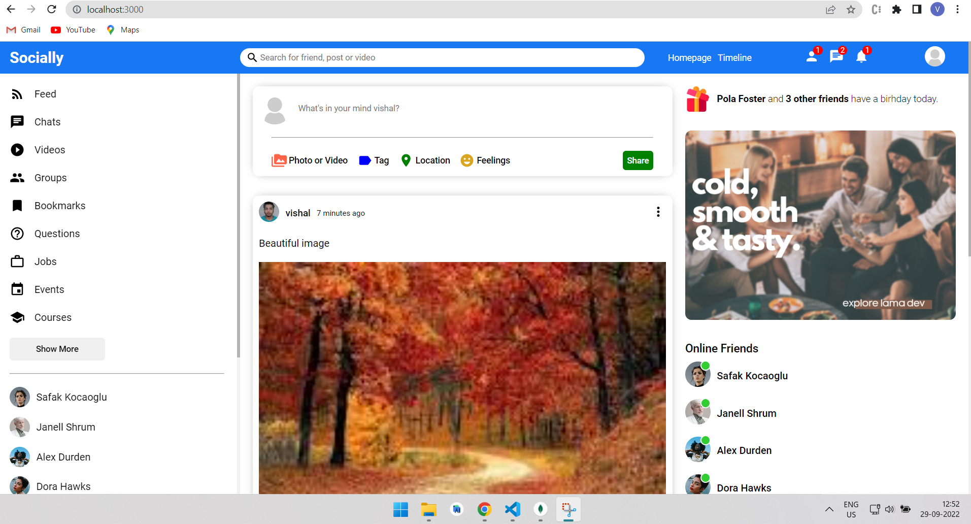
Main page:

Slide 6
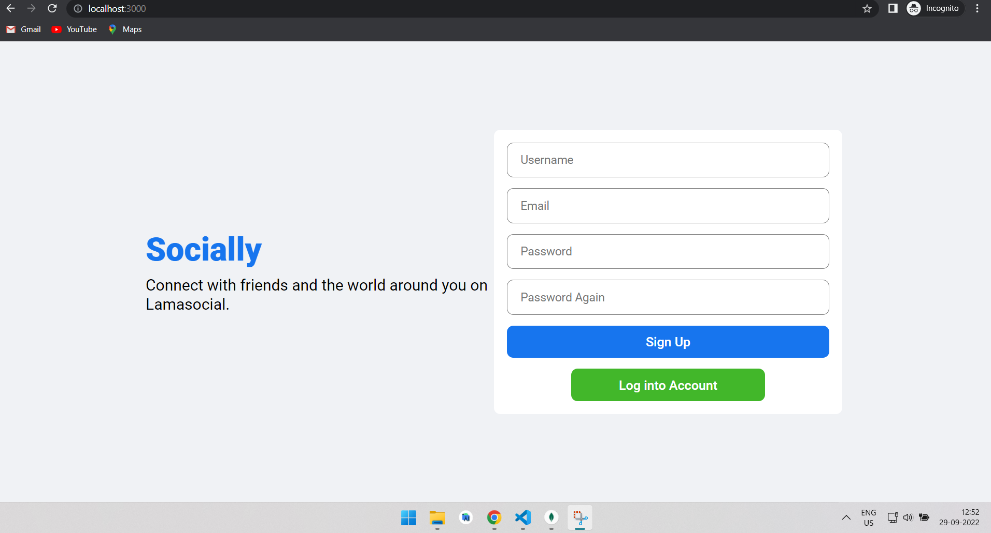
Log In page

Slide 7
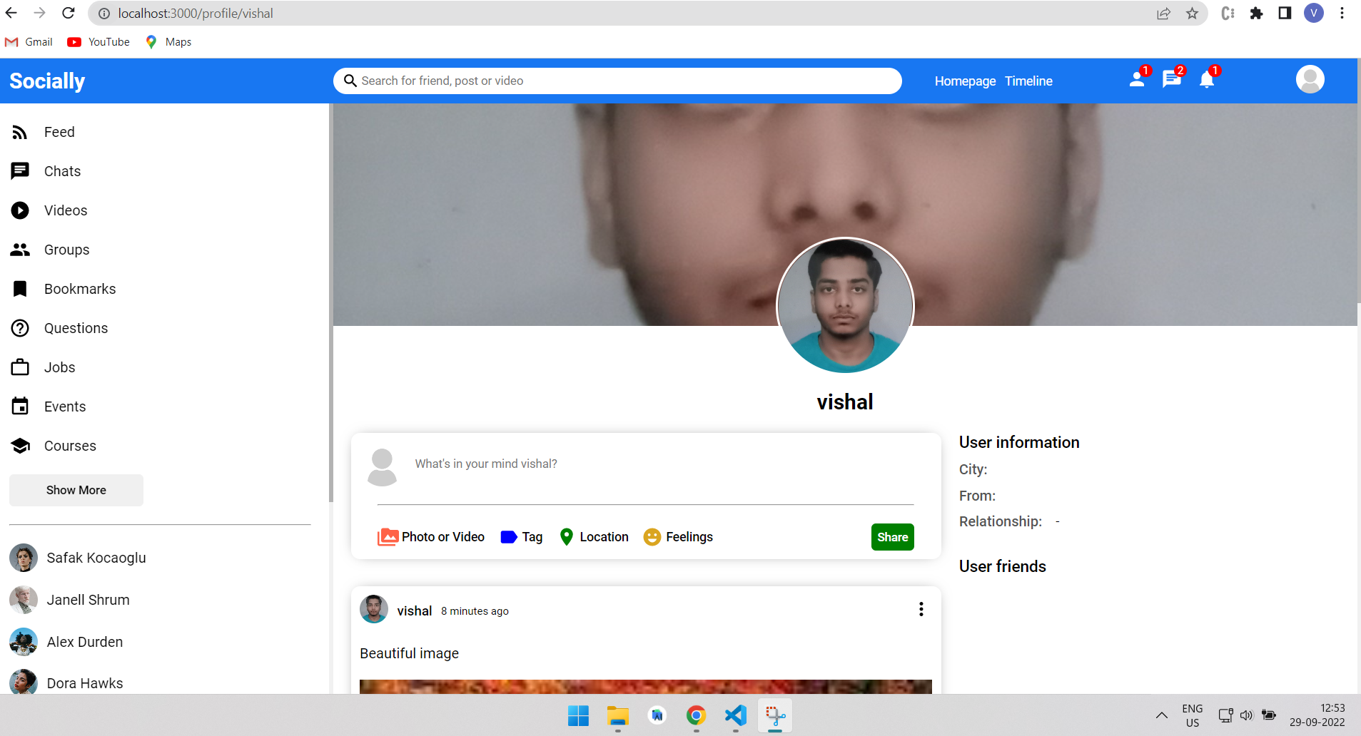
Profile section:

Slide 8
PROJECT OUTCOME:
Showing Empathy and Kindness
Offering Support
Better Communication
Spreading News
Building a Business
Establishing Authority
Driving Traffic
Enhancing the Customer Experience
Finding Your Voice
Staying Connected

Slide 9
Performance Evaluation in Machine Learning: The Good, The Bad, The Ugly and The Way Forward Reinforcement learning for robotic manipulation using simulated locomotion demonstrations A taxonomy of weight learning methods for statistical relational learning
Research Paper

Slide 10
Receiver operating characteristic (ROC) movies, universal ROC (UROC) curves, and coeffcient of predictive ability (CPA)
Algorithm for imbalanced data classification RB‐CCR: Radial‐Based Combined Cleaning and Resampling algorithm for imbalanced data classification
A review on deep learning in medical image analysis

Slide 11
HFPQ: deep neural network compression by hardware-friendly pruning-quantization
A review of deep learning used in the hyperspectral image analysis for agriculture

Slide 12
Abstract
Nowadays , large amount of data is available everywhere . Therefore , it is very important to analyze this data in order to extract some useful information and to develop an algorithm based on this analysis . This can be achieved through data mining and machine learning . Machine learning is an integral part of artificial intelligence , which is used to design algorithms based on the data trends and historical relationships between data . Machine learning is used in various fields such as bioinformatics , intrusion detection , Information retrieval , game playing , marketing , malware detection , image deconvolution and so on . This paper presents the work done by various authors in the field of machine learning in various application areas .

Slide 13


